Slide 1

Thermohydraulic Performance of Plain Twisted Tape Inserts with Oxide Nanofluids in Turbulent Tube Flow
ME1406: Minor Project Presentation
Presenters: Anamika Kumari (2024UGME048) · Aniket Aryan (2024UGME028) · Vimal Kumar(2024UGME042)
Supervisor: Dr. Laljee Prasad
Department of Mechanical Engineering, NIT Jamshedpur

Slide 2
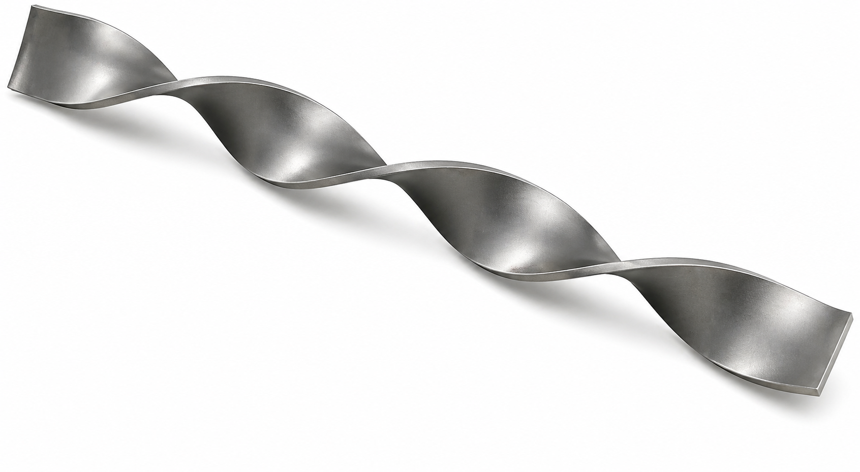
The Objective
Performance Study: To investigate thermohydraulic performance of plain twisted tape inserts in turbulent tube flow.
Nanofluid Comparison: To compare GO/water, CuO/water, and Al₂O₃/water as working fluids.
Twist Ratio Analysis: To study the effect of twist ratios 2, 3, and 4 on heat transfer and friction.
Flow and Concentration Effect: To evaluate Reynolds number and nanoparticle concentration effects on system performance.

Slide 3
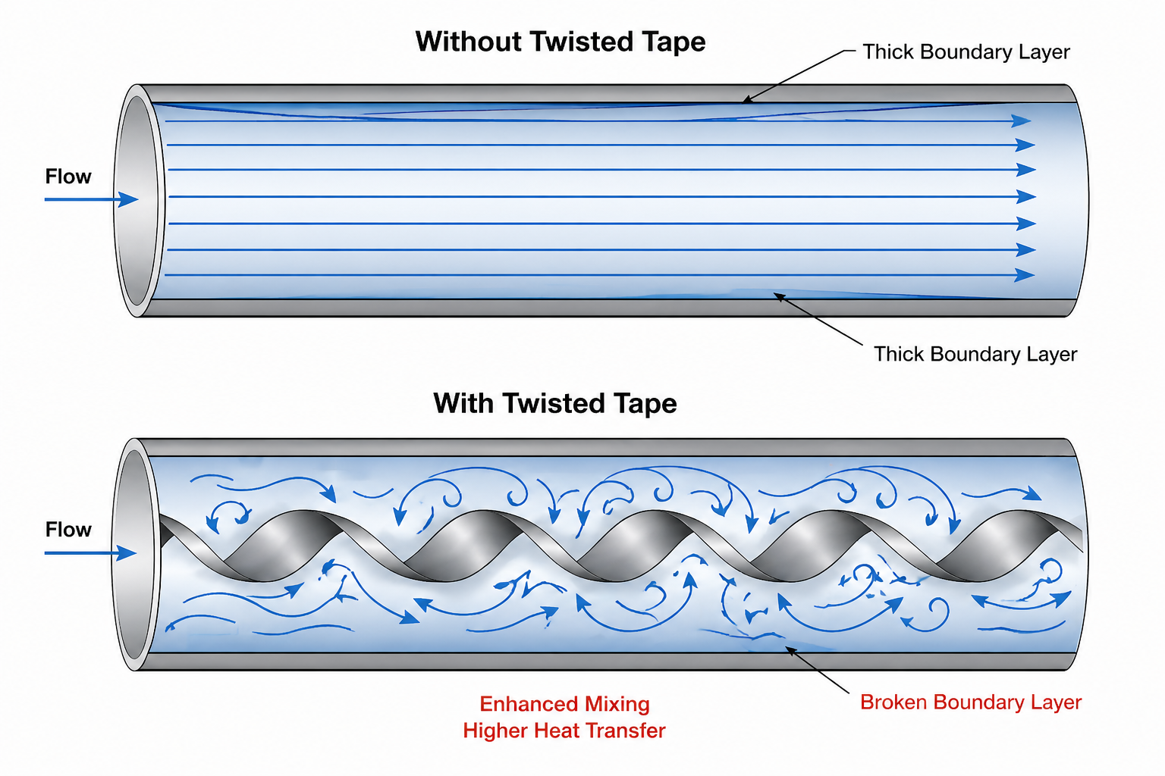
Introduction
Heat Transfer Need: Heat transfer enhancement is essential for improving thermal system efficiency in compact heat exchangers.
Passive Technique: Twisted tape inserts improve mixing and disturb the boundary layer, leading to better convective heat transfer.
Nanofluid Advantage: Oxide nanofluids offer higher thermal conductivity than water and can improve thermal performance.
Combined Effect: Using twisted tape inserts with nanofluids can improve heat transfer, though pressure drop must also be considered.

Slide 4
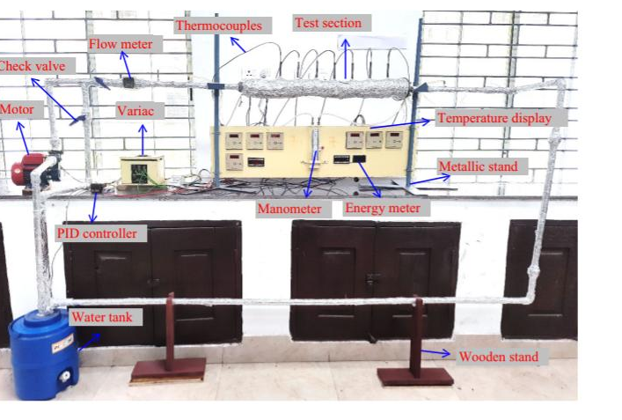
Experimental Setup & Methodology
Test Setup: GI tube of 800 mm length and 20 mm inner diameter fitted with plain twisted tape inserts of 18 mm width and 2 mm thickness at TR = 2, 3, and 4.
Instrumentation: Nichrome wire heater, K-type thermocouples, RTD Pt-100, rotameter, and U-tube manometer used for thermal and hydraulic measurements.
Nanofluids: Water, GO/water, CuO/water, and Al₂O₃/water tested at 0.1%, 0.3%, and 0.5% concentrations.
Methodology: Nanofluids were prepared using the two-step method with 90 min ultrasonication, and experiments were conducted after achieving steady-state conditions.
Analysis: Heat transfer and flow performance were evaluated using Nusselt number, friction factor, and thermohydraulic performance parameter.

Slide 5
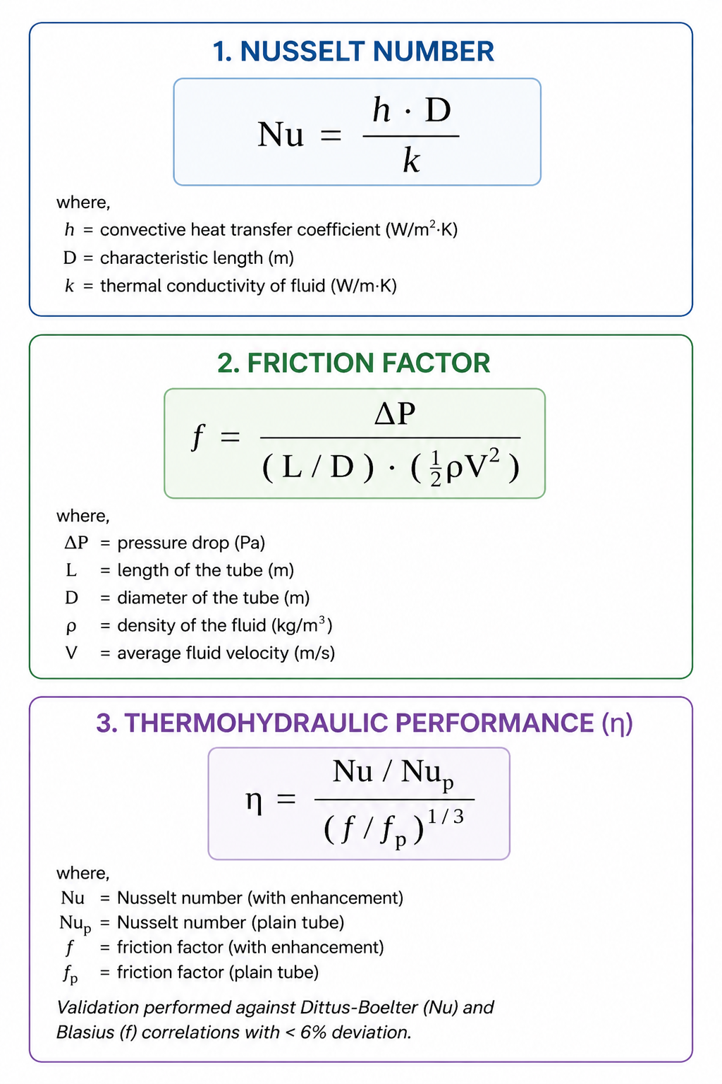
Performance Parameters
Nusselt Number: Indicates the extent of convective heat transfer enhancement achieved in the tube. Higher values reflect better thermal performance.
Friction Factor: Represents the pressure-drop penalty and flow resistance caused by the insert-fluid combination. Higher values indicate greater hydraulic loss.
Thermohydraulic Performance: Measures the overall benefit of heat transfer enhancement relative to the pressure-drop penalty, helping identify the best practical configuration.

Slide 6
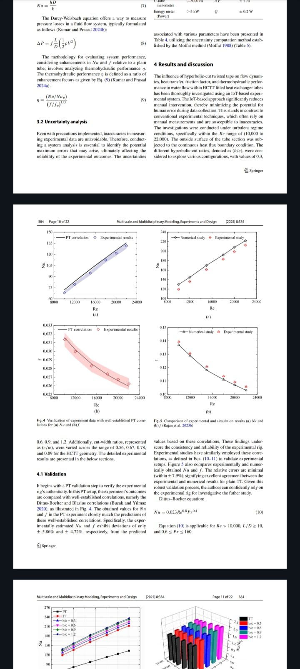
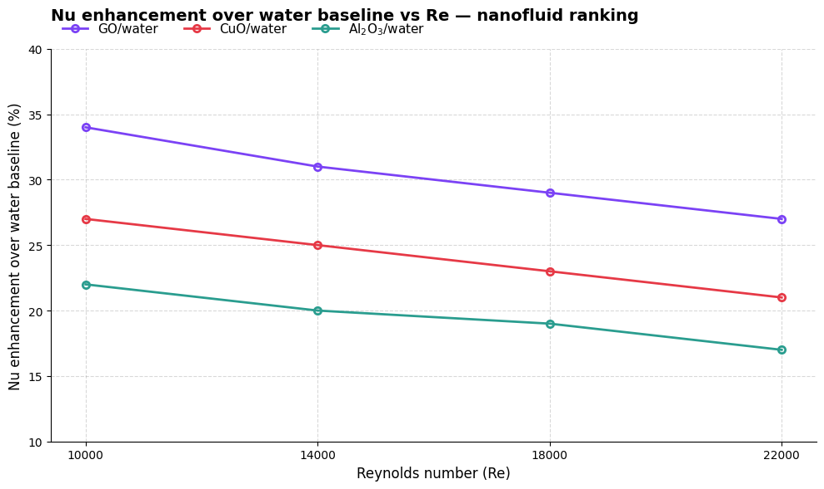
Observations
10000 14000 18000 12000
10000 12000 14000 16000 18000 22000
Nusselt number is maximum for GO/Water, signifying high heat transfer rate.
Friction factor is lowest for GO/water among all nanofluids, signifying lowest pressure drop among nanofluids.

Slide 7
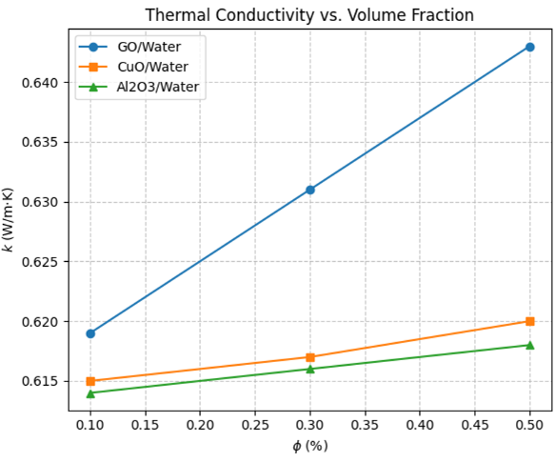
Thermophysical Properties
Density Trend: Nanofluid density increases with particle concentration.
Viscosity Trend: Viscosity increases with concentration, contributing to higher friction losses.
Specific Heat: Effective specific heat changes with nanoparticle loading.
Thermal Conductivity: GO/water shows the highest conductivity enhancement among the tested nanofluids.
Overall Effect: Improved thermophysical properties support higher heat transfer performance.
High thermal conductivity is the reason why GO/water provides best heat transfer.

Slide 8
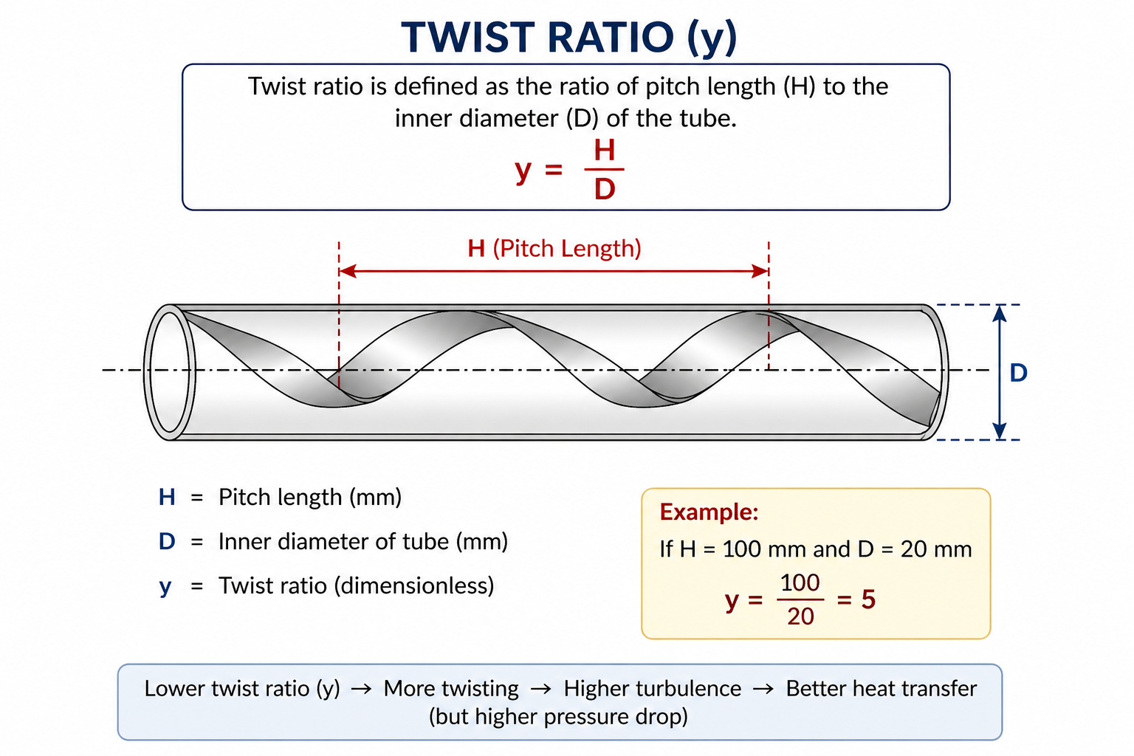
Effect of Twist Ratio
Heat Transfer Enhancement: Nusselt number increases as twist ratio decreases.
Best Heat Transfer: TR = 2 gives the maximum heat transfer enhancement.
Pressure Drop Penalty: Friction factor also rises at lower twist ratio due to stronger swirl generation.
Balanced Performance: TR = 3 provides the best thermohydraulic compromise for water-based operation.

Slide 9
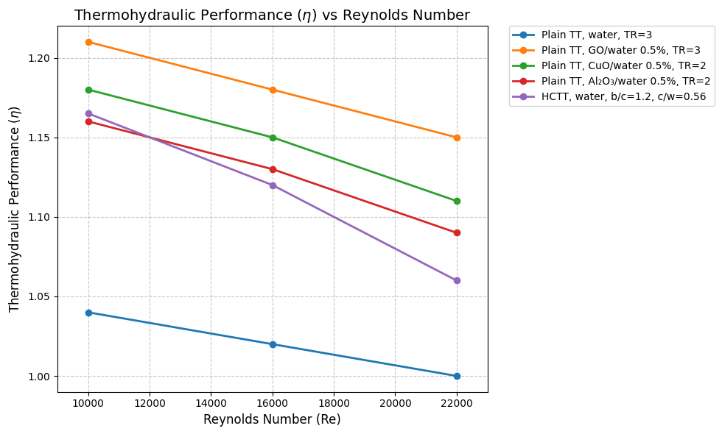
Thermohydraulic Performance : Ultimate Choice Making
GO/Water being significantly high as compared to all other analysed choices of nanofluids with plane twisted tape makes its best choice.

Slide 10
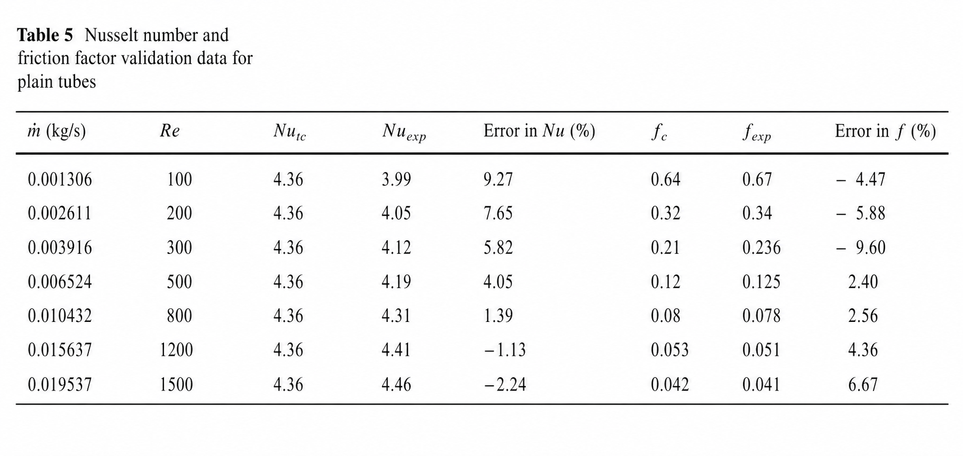
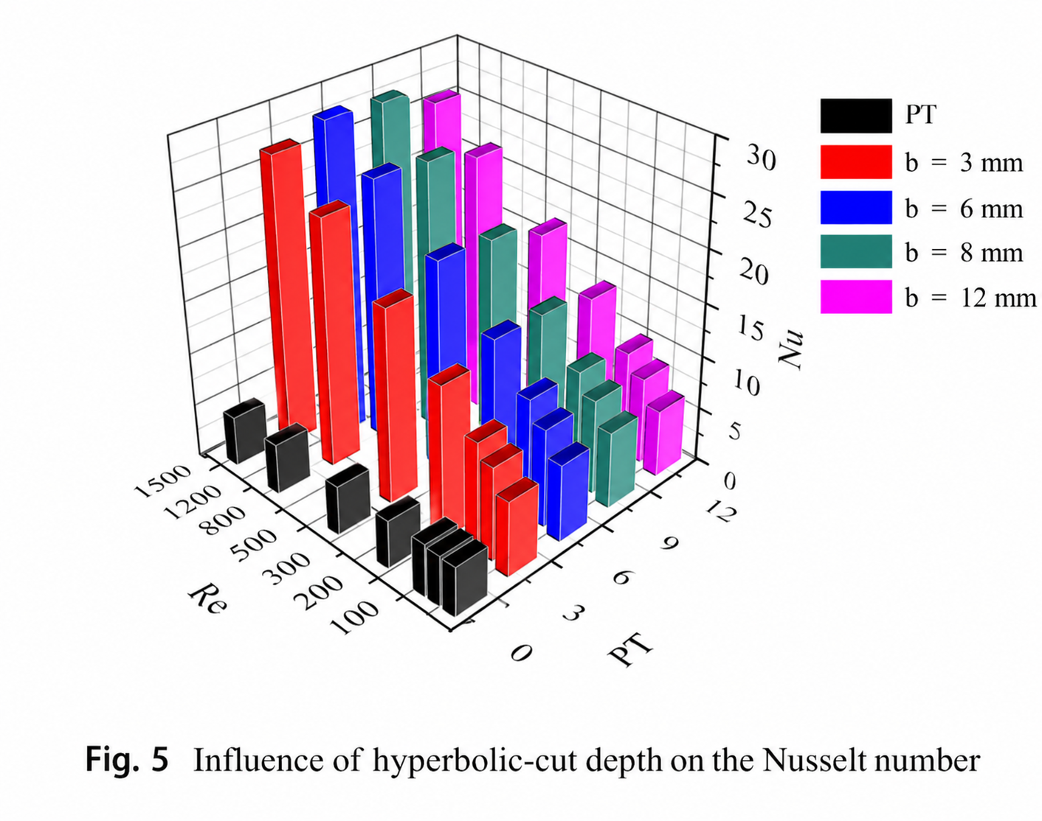
Validation

Slide 11
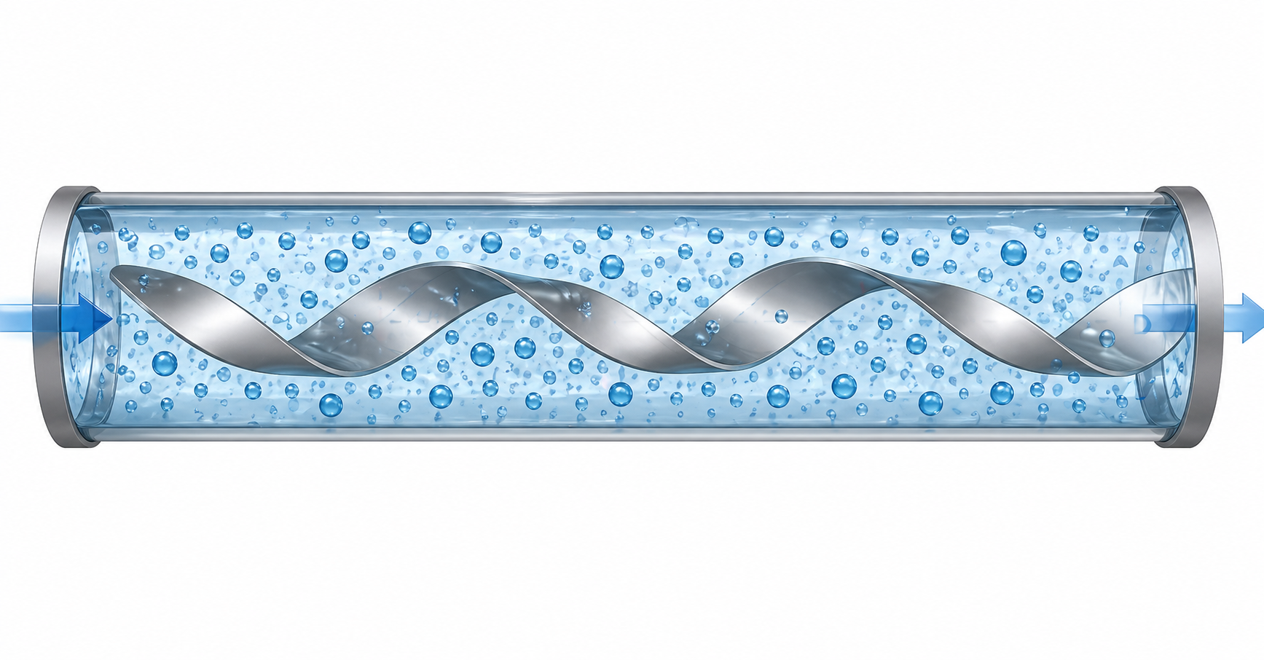
Conclusion
Performance Order: GO/water performs best, followed by CuO/water and Al₂O₃/water.
Concentration Effect: Heat transfer enhancement improves with increasing nanoparticle concentration.
Best Case: GO/water at 0.5% concentration gives the strongest heat transfer enhancement.
Approximate Improvement: Nusselt number enhancement is about 34% for GO/water, 27% for CuO/water, and 22% for Al₂O₃/water.
Trade-Off: Higher concentration also increases viscosity and pressure drop.

Slide 12
THANK YOU

